Slide 1

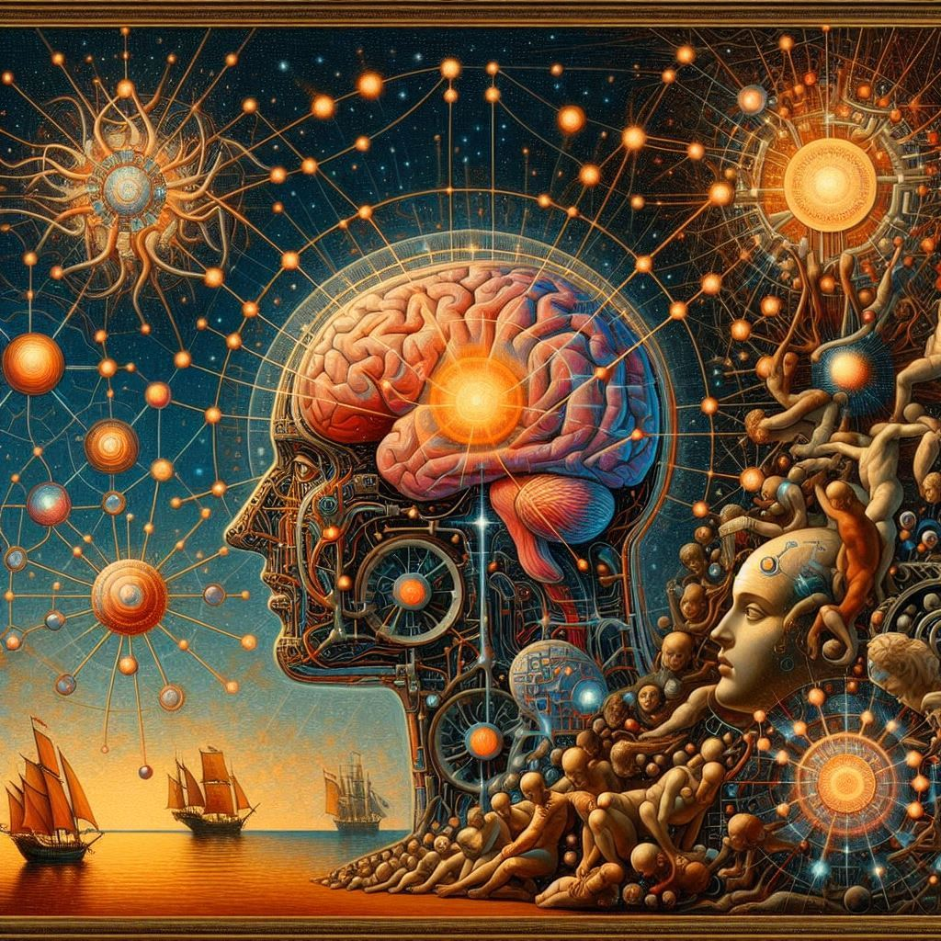

Generative AI use cases, project lifecycle, and model pre-training
Introduction to Machine Learning for Engineers
Ing. Fabio Antonini
Software Engineer

Slide 2


Title

Slide 3
Thank you for the attention
Fabio Antonini
Software Engineer
Fabio.antonini.1969@gmail.com

